Slide 1

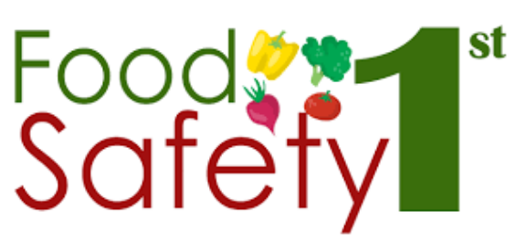
Food adulteration acts PART IV
Mary Anupama Palukurty
Assistant Professor,
Dept. of Biochemistry,
St.Joseph’s College for Women (A),
Visakhapatnam

Slide 2

PACKAGING ,PRODUCT LABELING AND NUTRITIONAL LABELING, ORGANIC FOODS
Labeling includes any written, printed or graphics present on the label, accompanies the food, or is displayed near the food.
Food Labeling serves as a primary link of communication between the food manufacturer and consumer.
Food labels provide information to help us make healthier and safer food choices.
The goal of food labeling is to provide consumers with information that is factual and relevant.

Slide 3
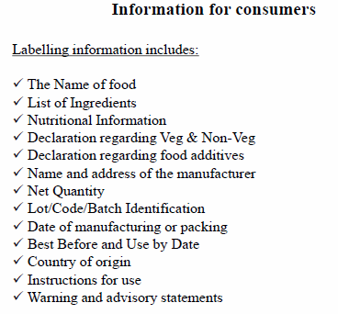
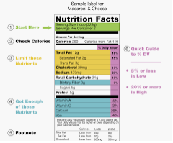

Slide 4
NAME OF THE FOOD AND INGREDIENTS
Name of the food shall include trade name, description and true nature of food.
If food has been processed, the process must be included in the title as eg., dried apricots, salted peanuts etc.
Ingredients used in the produced shall be listed in descending order of their composition by weight, at the time of manufacture.
Food additives and water must be included in the list.

Slide 5
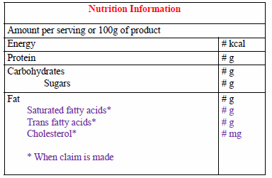
NUTRITIONAL INFORMATION
Nutritional information or nutritional facts per 100gm or 100ml or per serving of the product shall be given on the label containing the following:—
energy value in kcal;
the amounts of protein, carbohydrate (specify quantity of sugar) and fat in gram(g);
the amount of any other nutrient for which a nutrition or health claim is made
where the nutrition declaration is made per serving, the amount in gram(g) or milliliter(ml) in a serving shall be given.

Slide 6
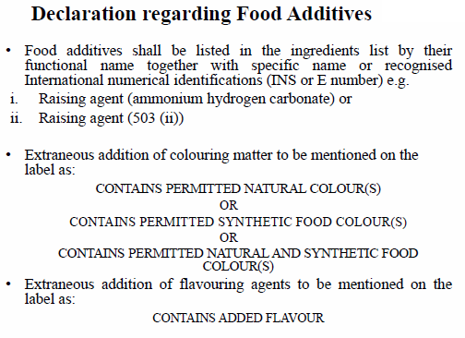

Slide 7
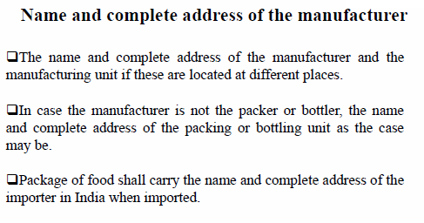

Slide 8
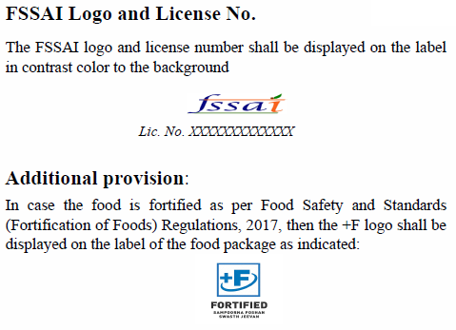
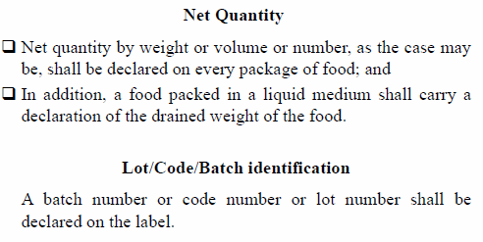

Slide 9
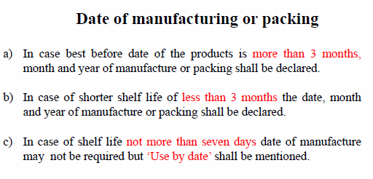

Slide 10
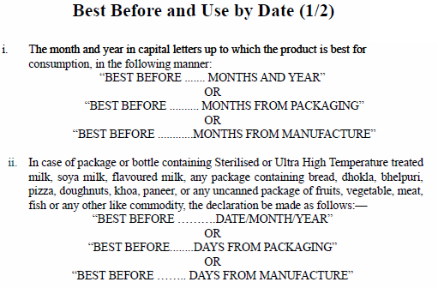

Slide 11
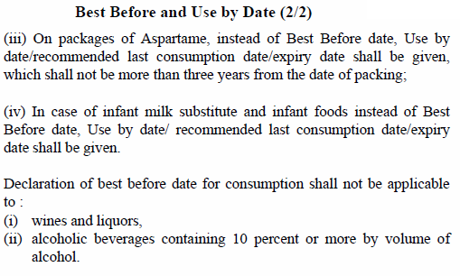

Slide 12
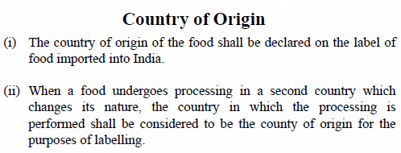
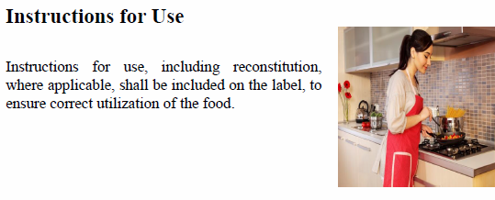

Slide 13
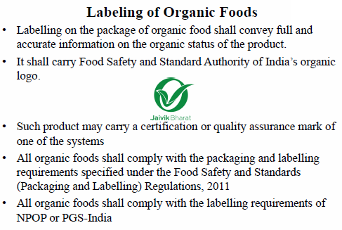

Slide 14
NEWER APPROACHES TO FOOD SAFETY
Scientific advances are one factor responsible for the increased attention to food-safety regulation. New pathogen tests and methods of detection have improved.
Improved tests for pesticide residues can now detect parts per billion of many chemical compounds, leading to more frequent findings and thereby increasing concern about the existence of pesticide residues in food and water.
Even though risks to human health are extremely low at such minute levels, these findings show that consumers are exposed to a number of residues, and the risks from multiple exposures are not well understood or quantified.

Slide 15
SETTING NEW STANDARDS
Many different Federal agencies have responsibilities for food safety
For example, FDA has the regulatory responsibility for most foods.
The U.S. Department of Agriculture (USDA) inspects meat and poultry.
The Environmental Protection Agency (EPA) sets tolerances for pesticide residues in foods.
These Federal agencies are trying new approaches to food-safety regulation.
Regulations by USDA, FDA, and EPA are under agency, congressional, and Presidential review and debate. Some new initiatives include:

Slide 16
One element of the new food safety initiatives involves changing the standards for acceptable risks.
EPA is responsible for setting pesticide residue tolerances (the maximum level of residue that can legally remain on the food product) for pesticides used on food crops.
Presently, under the Delaney Clause of the Federal Food, Drug, and Cosmetic Act (FFOCA), carcinogenic food additives are illegal, without regard to whether the risk is "negligible" and without regard to other characteristics, such as benefits of product use.
However, this "zero-tolerance" clause applies only to pesticide residues that are used or that concentrate in processed foods.
For fresh foods, small risks are allowed, particularly if there are substantial benefits from product use. The Administration's

Slide 17
SOME PARTS OF RISK ANALYSIS MAY INCLUDE
• Identifying food borne hazards capable of causing human illness.
• Estimating the total number of acute and chronic illnesses associated with each hazard that occurs annually.
• Estimating the number of deaths and illnesses, and the severity of illnesses associated with each hazard (while deaths are the most important measure, the greater number of less severe outcomes, such as illness, could impose greater costs on society).
• Identifying alternative methods of controlling food bome hazards.
• Estimating the economic costs and benefits of the proposed control technology and the distribution of such costs and benefits.

Slide 18
THANK YOU

